Slide 1
Target market
Hospitality and tourism industry

Slide 2
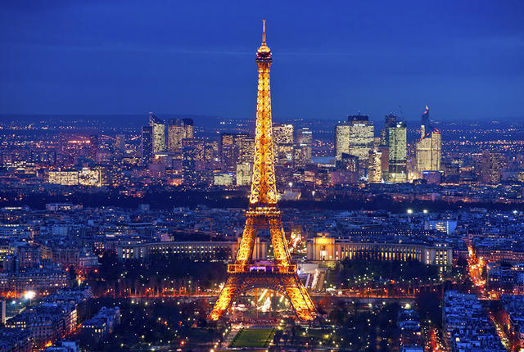
Travel Tidbit
What is the #1 Tourist attraction in the world?

Slide 3
Customers vs Consumers
Customers = buy the product
Consumers = use the product

Slide 4
Target market
Focusing all marketing mix decisions on the specific group of people you want to reach

Slide 5
Eiffel Tower information
Eiffel tower visitor information

Slide 6
How can we classify the visitors
Market segmentation
Demographics
geographics
Psychographics
Product benefits

Slide 7
Demographics
Describe a population in terms of personal characteristics
Age
Gender
Income
Ethnic Background
Occupation

Slide 8
Geographics
segmentation of the market based on where people live; local, regional, national, or even geographic markets

Slide 9
psychographics
studies of consumers based on social and psychological characteristics; people’s attitudes and values, lifestyles—how people spend their money and time
TRENDS

Slide 10
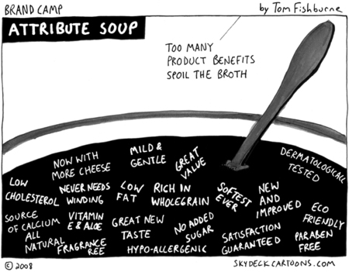
Product benefits
Companies market benefits, not just the physical characteristics of a product

Slide 11
examples

Slide 12
Examples

Slide 13
example

Slide 14
What famous campaign has a DMO come up with for
New york?

Slide 15
History of the advertising campaign
History of I Love NY Campaign
I love NY Website: http://www.iloveny.com/
Look at various I love NY Commercials

Slide 16
Assignment
You and your partner have been hired by governor cuomo as the new DMO for NYS!!!
You must first select a market to target
Create a logo specifically geared towards that market
Make a presentation to the class informing us:
Who you are targeting/why/how
How it will be used
What hospitality and tourism outlets will be effected (hotels/attractions/food/travel and tourism, etc….)

